Slide 1
Latent Semantic Analysis
Hongning Wang
CS@UVa

Slide 2
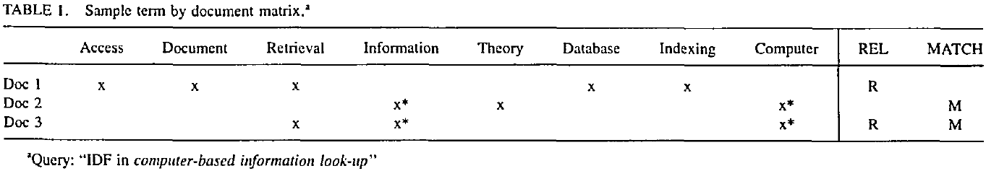
VS model in practice
Document and query are represented by term vectors
Terms are not necessarily orthogonal to each other
Synonymy: car v.s. automobile
Polysemy: fly (action v.s. insect)

Slide 3
Choosing basis for VS model
A concept space is preferred
Semantic gap will be bridged
Finance
D₂
D₄
D₃
Sports
Query
D₁
Education
D₅

Slide 4
How to build such a space
Automatic term expansion
Construction of thesaurus
WordNet
Clustering of words
Word sense disambiguation
Dictionary-based
Relation between a pair of words should be similar as in text and dictionary’s descrption
Explore word usage context

Slide 5
How to build such a space
Latent Semantic Analysis
Assumption: there is some underlying latent semantic structure in the data that is partially obscured by the randomness of word choice with respect to retrieval
It means: the observed term-document association data is contaminated by random noise

Slide 6
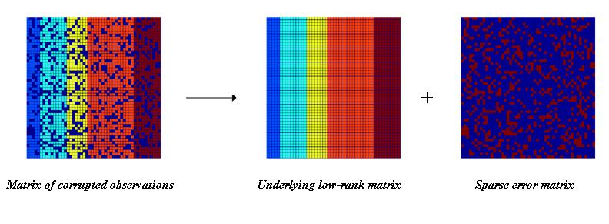
How to build such a space
Solution
Low rank matrix approximation
Imagine this is *true* concept-document matrix
Imagine this is our observed term-document matrix
Random noise over the word selection in each document

Slide 7
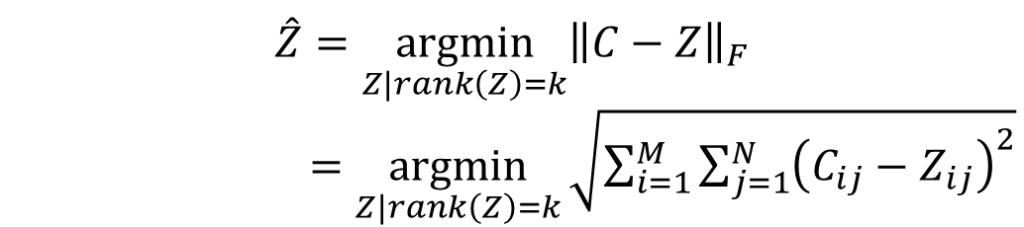
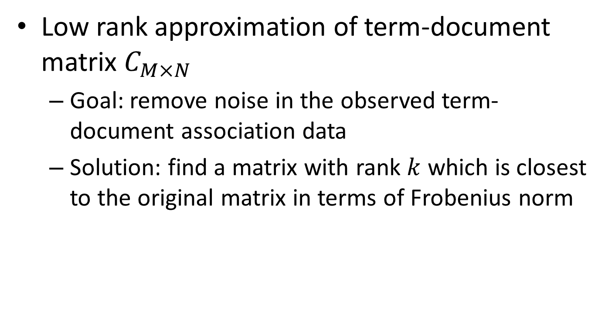
Latent Semantic Analysis (LSA)
Low rank approximation of term-document matrix $C_{M×N}$
Goal: remove noise in the observed term-document association data
Solution: find a matrix with rank $k$ which is closest to the original matrix in terms of Frobenius norm
$$\hat{Z}=\underset{Z|rank\left(Z\right)=k}{argmin}{{\left\|C−Z\right\|}_{F}}$$
$=\underset{Z|rank\left(Z\right)=k}{argmin}{\sqrt{\sum_{i=1}^{M}{\sum_{j=1}^{N}{{\left(C_{ij}−Z_{ij}\right)}^{2}}}}}$

Slide 8
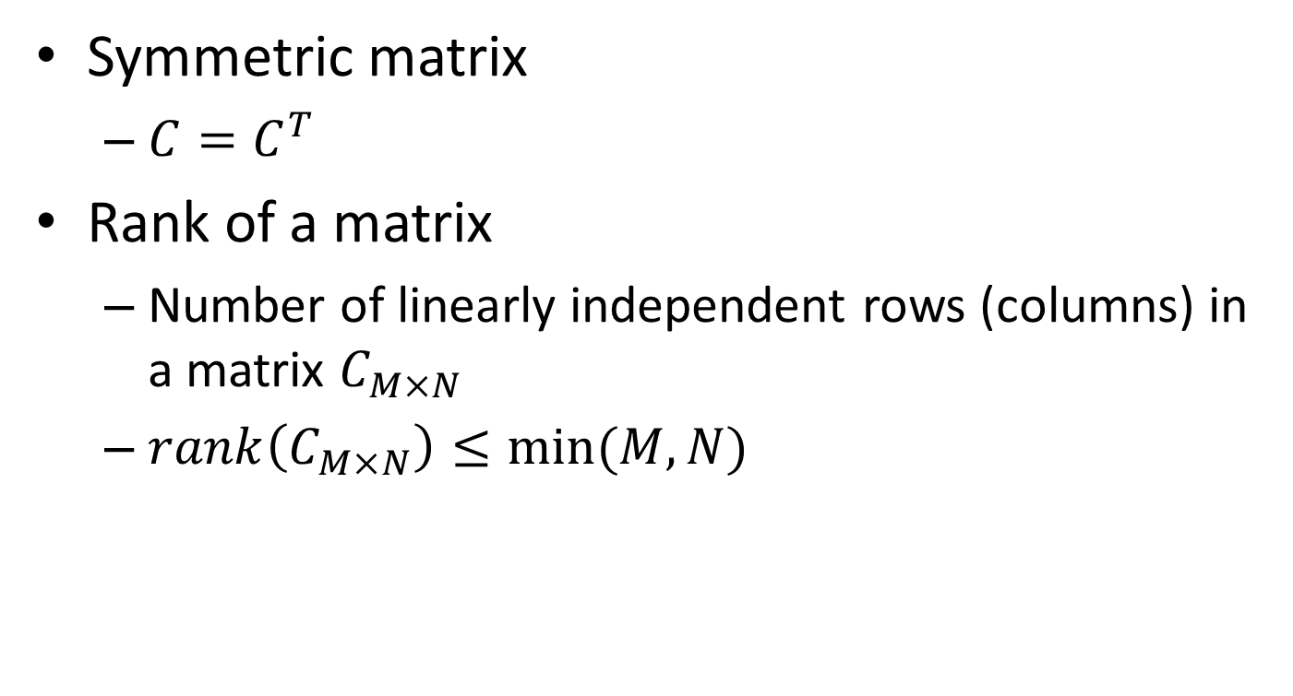
Basic concepts in linear algebra
Symmetric matrix
$C=C^{T}$
Rank of a matrix
Number of linearly independent rows (columns) in a matrix $C_{M×N}$
$rank\left(C_{M×N}\right)≤min⁡(M,N)$

Slide 9
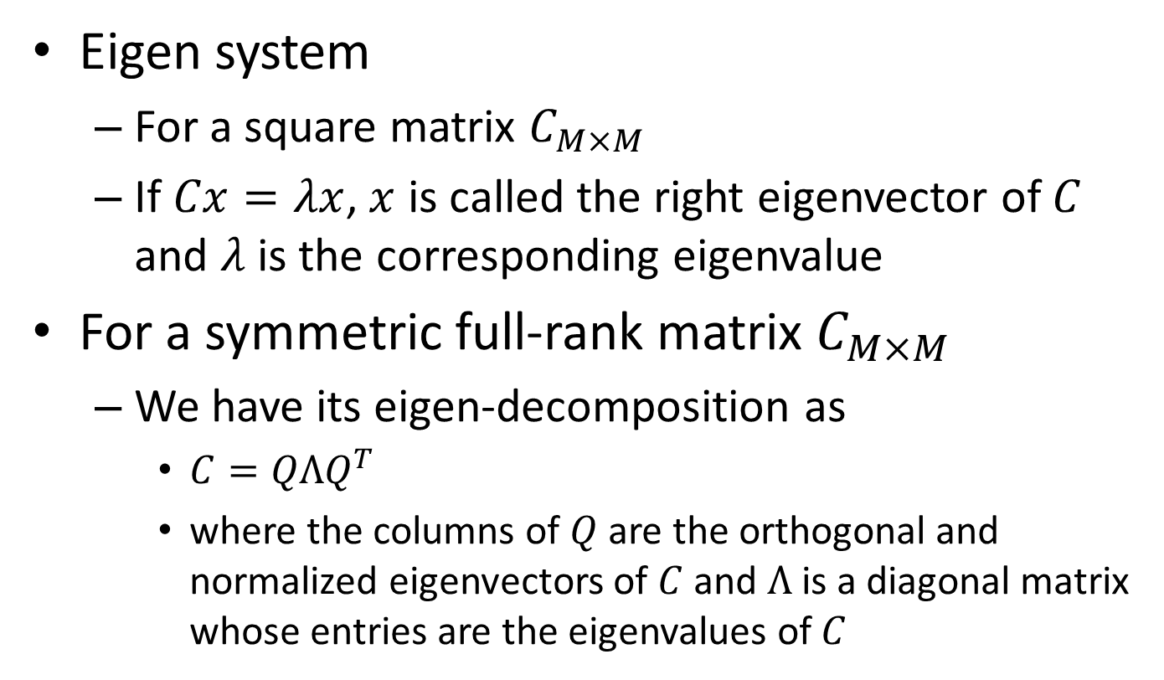
Basic concepts in linear algebra
Eigen system
For a square matrix $C_{M×M}$
If $Cx=λx$, $x$ is called the right eigenvector of $C$ and $λ$ is the corresponding eigenvalue
For a symmetric full-rank matrix $C_{M×M}$
We have its eigen-decomposition as
$C=QΛQ^{T}$
where the columns of $Q$ are the orthogonal and normalized eigenvectors of $C$ and $Λ$ is a diagonal matrix whose entries are the eigenvalues of $C$

Slide 10
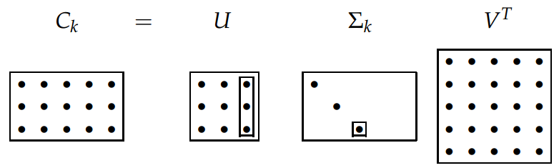

Basic concepts in linear algebra
Singular value decomposition (SVD)
For matrix $C_{M×N}$ with rank $r$, we have
$C=UΣV^{T}$
where $U_{M×r}$ and $V_{N×r}$ are orthogonal matrices, and $Σ$ is a $r×r$ diagonal matrix, with $Σ_{ii}=\sqrt{λ_{i}}$ and $λ_{1}…λ_{r}$ are the eigenvalues of $CC^{T}$
We define $C_{M×N}^{k}=U_{M×k}Σ_{k×k}V_{N×k}^{T}$
where we place $Σ_{ii}$ in a descending order and set $Σ_{ii}=\sqrt{λ_{i}}$ for $i≤k$, and $Σ_{ii}=0$ for $i>k$

Slide 11
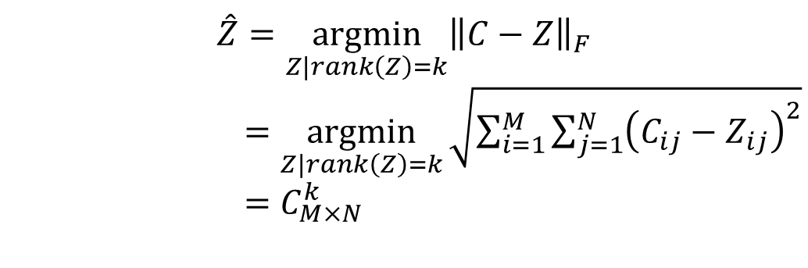

Latent Semantic Analysis (LSA)
Solve LSA by SVD
Procedure of LSA
Perform SVD on document-term adjacency matrix
Construct $C_{M×N}^{k}$ by only keeping the largest $k$ singular values in $Σ$ non-zero
Map to a lower dimensional space
$$\hat{Z}=\underset{Z|rank\left(Z\right)=k}{argmin}{{\left\|C−Z\right\|}_{F}}$$
$=\underset{Z|rank\left(Z\right)=k}{argmin}{\sqrt{\sum_{i=1}^{M}{\sum_{j=1}^{N}{{\left(C_{ij}−Z_{ij}\right)}^{2}}}}}$
$=C_{M×N}^{k}$

Slide 12
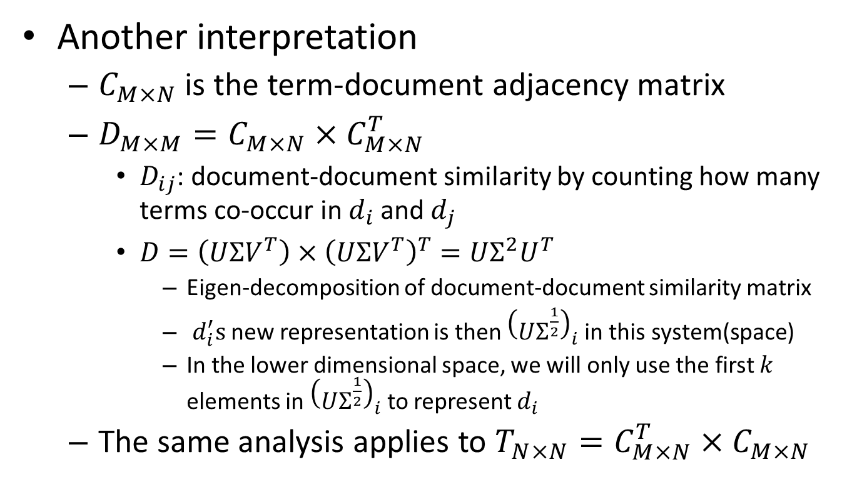
Latent Semantic Analysis (LSA)
Another interpretation
$C_{M×N}$ is the term-document adjacency matrix
${D_{M×M}=C}_{M×N}×C_{M×N}^{T}$
$D_{ij}$: document-document similarity by counting how many terms co-occur in $d_{i}$ and $d_{j}$
$D=\left(UΣV^{T}\right)×{\left(UΣV^{T}\right)}^{T}=UΣ^{2}U^{T}$
Eigen-decomposition of document-document similarity matrix
$d_{i}^{′}s$new representation is then ${\left(UΣ^{\frac{1}{2}}\right)}_{i}$ in this system(space)
In the lower dimensional space, we will only use the first $k$ elements in ${\left(UΣ^{\frac{1}{2}}\right)}_{i}$ to represent $d_{i}$
The same analysis applies to ${T_{N×N}=C}_{M×N}^{T}×C_{M×N}$

Slide 13
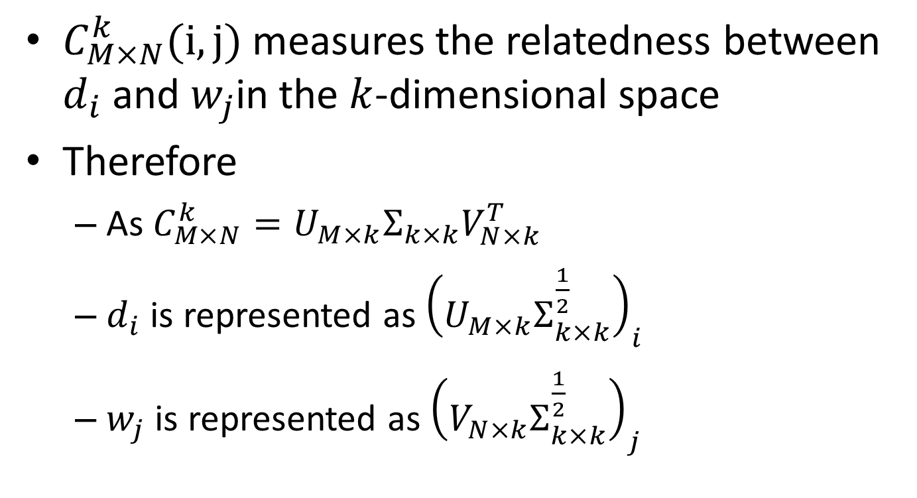
Geometric interpretation of LSA
$C_{M×N}^{k}(i,j)$ measures the relatedness between $d_{i}$ and $w_{j}$in the $k$-dimensional space
Therefore
As$C_{M×N}^{k}=U_{M×k}Σ_{k×k}V_{N×k}^{T}$
$d_{i}$ is represented as ${\left(U_{M×k}Σ_{k×k}^{\frac{1}{2}}\right)}_{i}$
$w_{j}$ is represented as ${\left(V_{N×k}Σ_{k×k}^{\frac{1}{2}}\right)}_{j}$

Slide 14
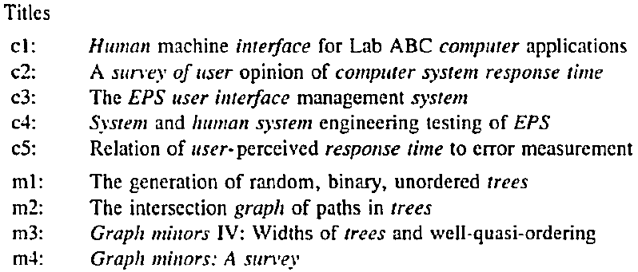
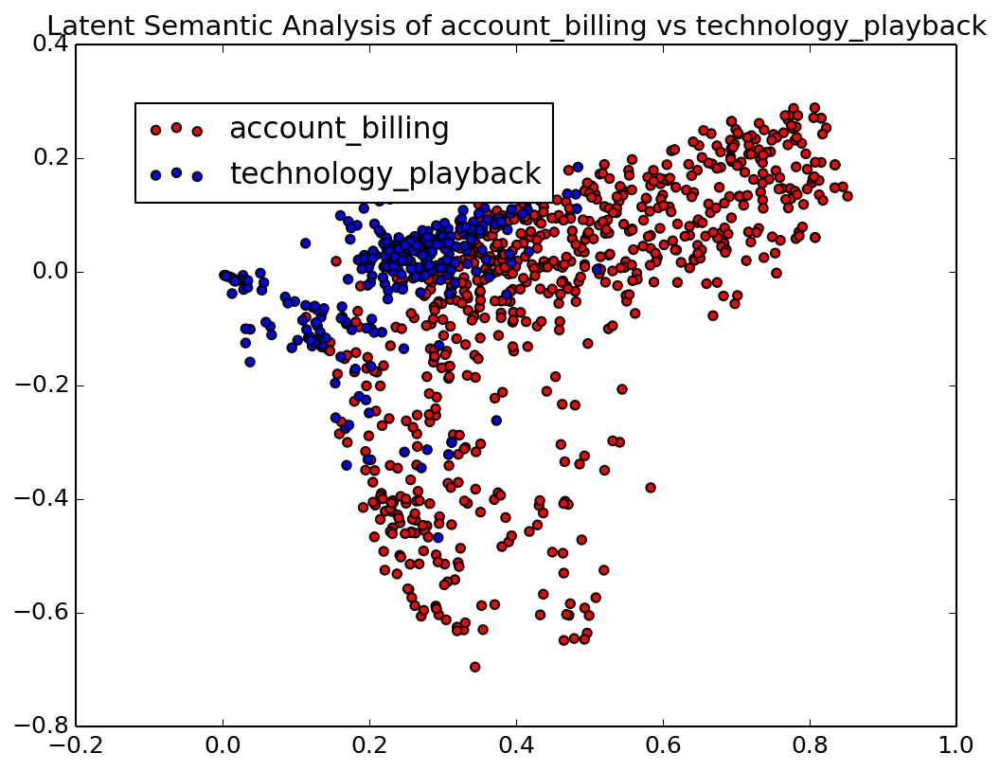
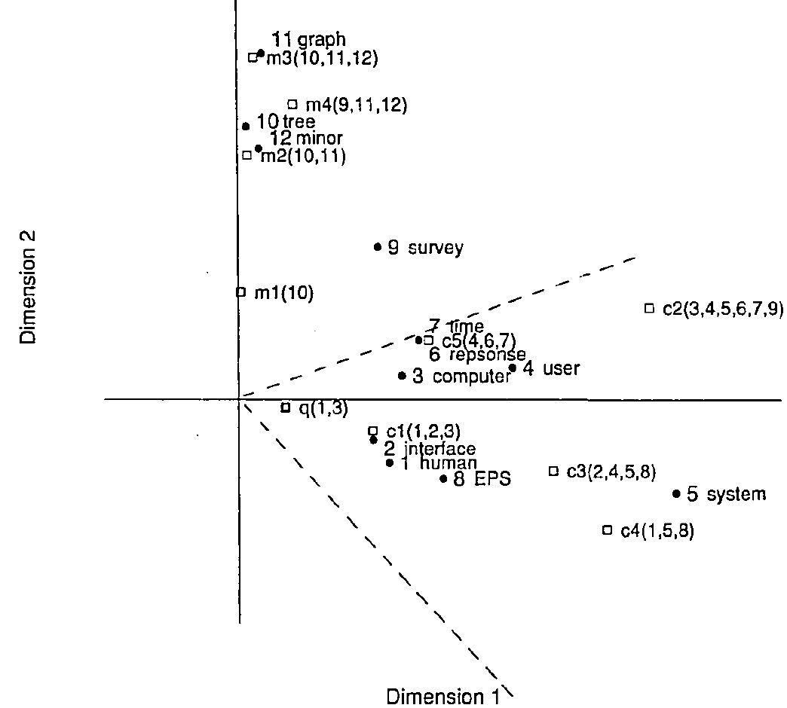
Latent Semantic Analysis (LSA)
HCI
Visualization
Graph theory

Slide 15
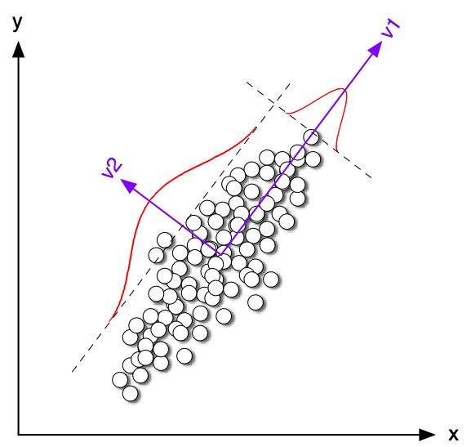
What are those dimensions in LSA
Principle component analysis

Slide 16
Latent Semantic Analysis (LSA)
What we have achieved via LSA
Terms/documents that are closely associated are placed near one another in this new space
Terms that do not occur in a document may still close to it, if that is consistent with the major patterns of association in the data
A good choice of concept space for VS model!

Slide 17
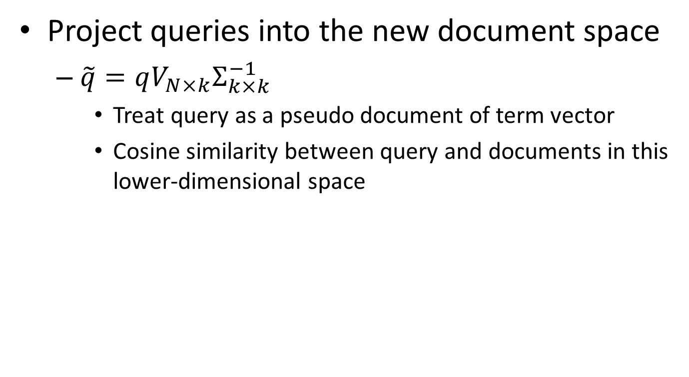
LSA for retrieval
Project queries into the new document space
$\tilde{q}=qV_{N×k}Σ_{k×k}^{−1}$
Treat query as a pseudo document of term vector
Cosine similarity between query and documents in this lower-dimensional space

Slide 18
LSA for retrieval
HCI
Graph theory
q: “human computer interaction”

Slide 19
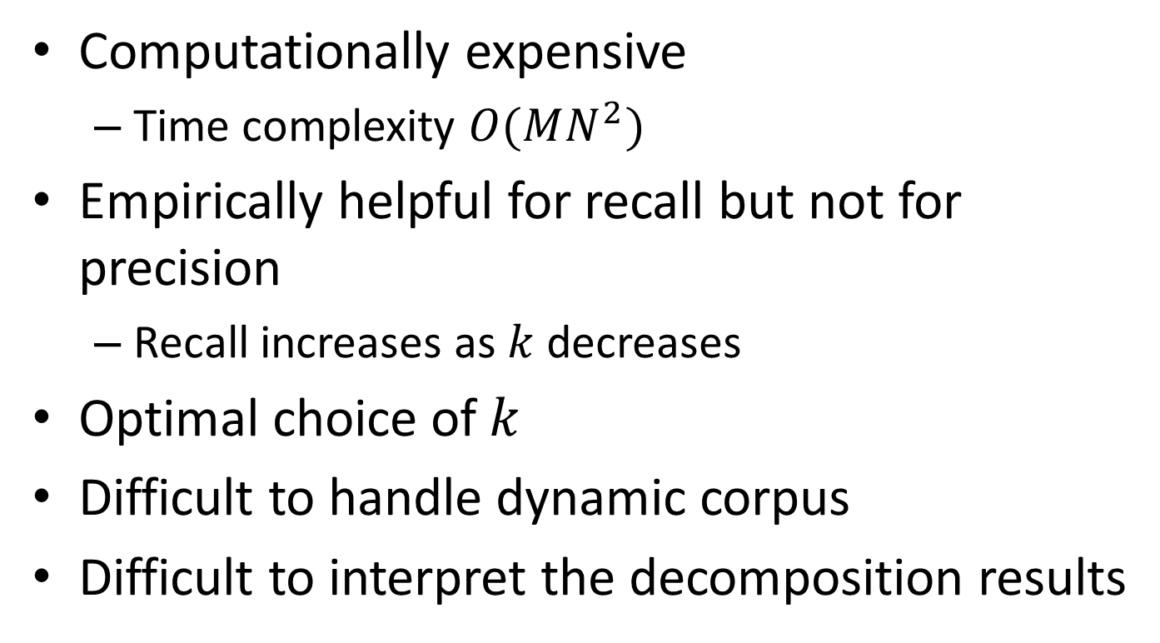
Discussions
Computationally expensive
Time complexity $O(MN^{2})$
Empirically helpful for recall but not for precision
Recall increases as $k$ decreases
Optimal choice of $k$
Difficult to handle dynamic corpus
Difficult to interpret the decomposition results
We will come back to this later!

Slide 20
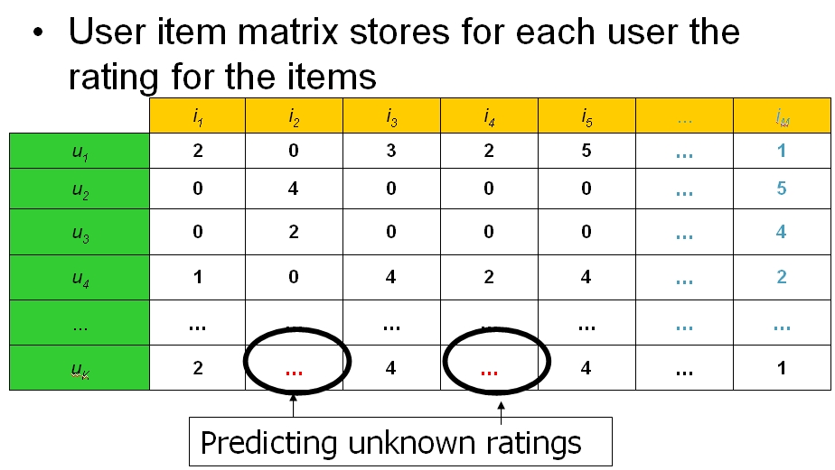
LSA beyond text
Collaborative filtering

Slide 21
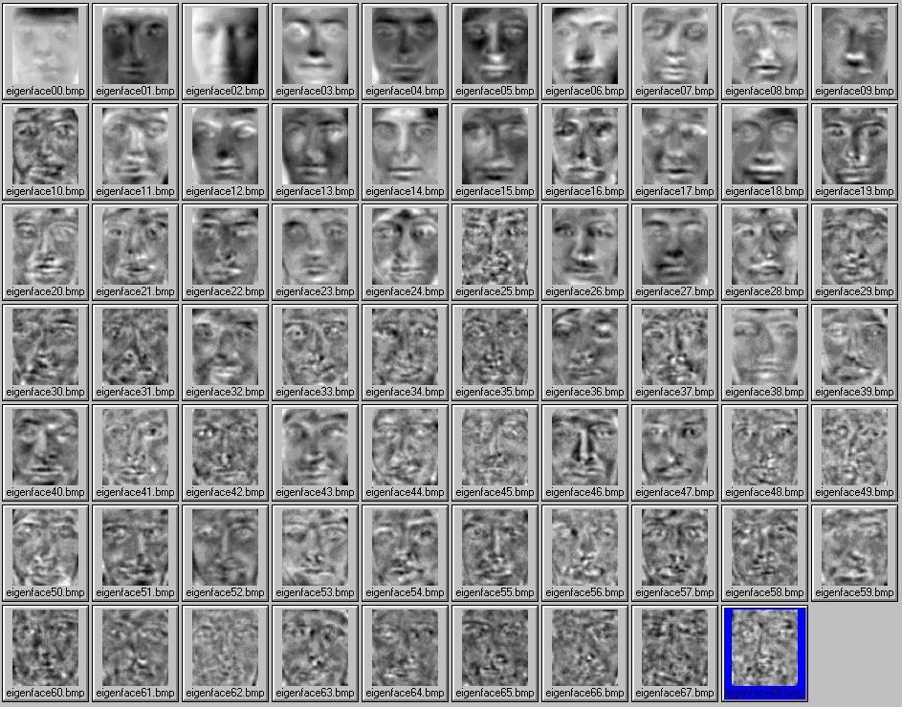
LSA beyond text
Eigen face

Slide 22
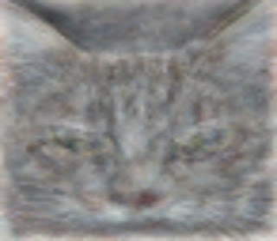
LSA beyond text
Cat from deep neuron network
One of the neurons in the artificial neural network, trained from still frames from unlabeled YouTube videos, learned to detect cats.

Slide 23
What you should know
Assumption in LSA
Interpretation of LSA
Low rank matrix approximation
Eigen-decomposition of co-occurrence matrix for documents and terms
LSA for IR

